Slide 1
Where are we now?
Updates to the Canadian child care system from 2000 to the present.

Slide 2
MULTILATERAL FRAMEWORK AGREEMENT ON EARLY LEARNING AND CHILDCARE
Negotiated by the Human Resources Minister at the time, Jane Stewart, the Multilaterial Framework Agreement on Early Learning and Child Care (MFA), announced financial support for child care services. This was the first time since the Second World War that the federal government made a commitment to funding child care services.
2003

Slide 4
"THE FOUNDATIONS PROGRAM"
2004
Ken Dryden, a Minister under Prime Minister Paul Martin, began negotiations between the federal government and the provinces with details being completed by the end of 2005. Ten agreements were in place, but were not introduced as the Liberals were then replaced by the Conservatives under Stephen Harper.

Slide 5

"CHILD CARE FOR A CHANGE!" THE THIRD NATIONAL CHILD CARE CONFERENCE
2004
650 delegates gathering in Winnipeg for the third national conference, where public opinion had largely shifted towards accepting the importance of government responsibility for child care (In 2003, 85% of Canadians indicated that they supported a publicly-funded system). Participants attended workshops, and attended a town hall session on the final day with senior politicians in attendance. Of particular significance was the agreement of conference delegates that universal, publicly-funded child care was an agreed upon goal.

Slide 6
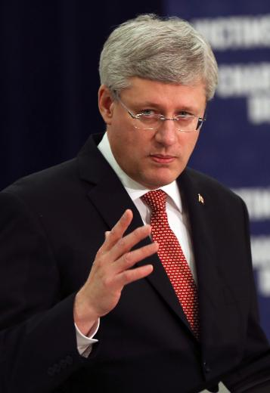
STEPHEN HARPER'S CANCELLATION OF PROGRAMS
2006
Upon his election, Stephen Harper quickly moved to cancel the Liberals' plans for a national child care system (as proposed in 2004). Instead, Harper introduced the Universal Child Care Benefit (UCCB), giving families $100 per month for children up to five years of age.

Slide 7
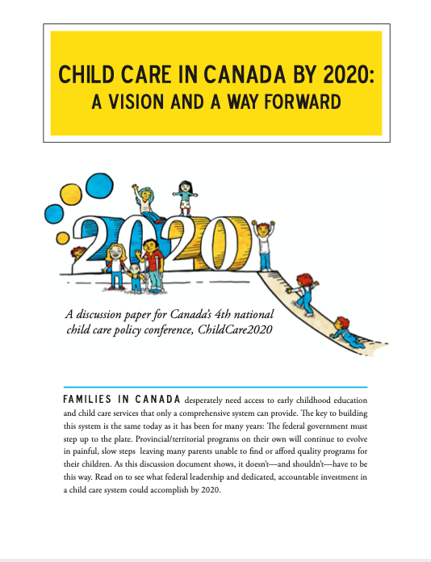
CHILDCARE2020, THE FOURTH NATIONAL CHILD CARE CONFERENCE
2014
Taking place in Winnipeg, more than 600 delegates gathered for the Fourth National Child Care Conference. Entitled ChildCare 2020, the conference focused on the importance of creating an updated child care system that reflected the needs of Canadians by 2020.

Slide 8
MULTILATERAL EARLY LEARNING AND CHILD CARE FRAMEWORK
This framework, as published in 2017, emphasizes the "importance of supporting parents, families, and communities in their efforts to ensure the best possible future for their children." It outlines a governmental commitment towards improved quality, accessibility, affordability, flexibility and inclusivity in early learning and child care.
2017
Notes:
https://www.canada.ca/en/employment-social-development/programs/early-learning-child-care/reports/2017-multilateral-framework.html

Slide 9

INDIGENOUS EARLY LEARNING AND CHILD CARE FRAMEWORK
2018
The preamble notes "the Indigenous Early Learning and Child Care Framework represents the Government of Canada and Indigenous peoples' work to co-develop a transformative Indigenous framework that reflects the unique cultures, aspirations and needs of First Nations, Inuit and Metis children across Canada."
Notes:
https://www.canada.ca/en/employment-social-development/programs/indigenous-early-learning/2018-framework.html

Slide 10
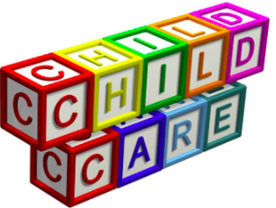
Where are we now…….?
Many families are forced to decide whether or not the cost of child care is worth it when compared to their annual income.
The federal government has now signed agreements with every province and territory to reduce child care fees and make child care more accessible for families.
This change is the result of decades of activism for an affordable and quality child care system.
2022
Notes:
CBC news – “Ontario reaches $10.2B child-care deal: Here's what parents need to know” - https://www.cbc.ca/news/canada/toronto/ontario-child-care-deal-ford-trudeau-1.6399694

